Slide 1
Static and Dynamic Binding

Slide 2
Binding means an association of method call to the method definition. There are two types of Binding: Static and Dynamic Binding in Java.
If the compiler maps the method at compile-time, it is Static Binding or early binding. And, if the method is resolved at runtime, it is Dynamic Binding or late binding.
We have discussed the topic of Polymorphism in Java. Polymorphism in Java is one of the OOPs features that allows an object to occur in multiple forms. When a method exhibits polymorphism, the compiler maps the name of the method to the final implementation.

Slide 3
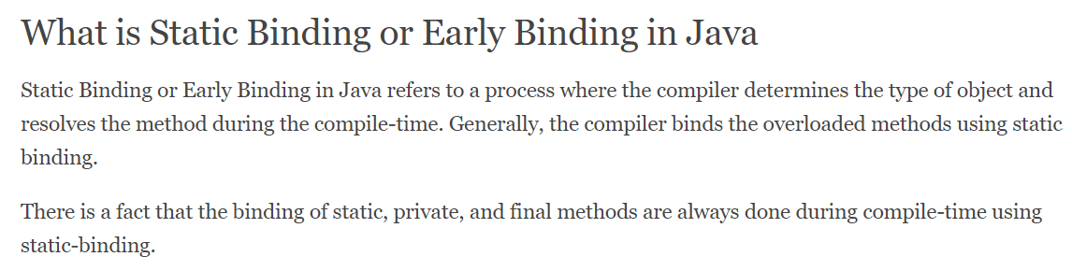

Slide 4
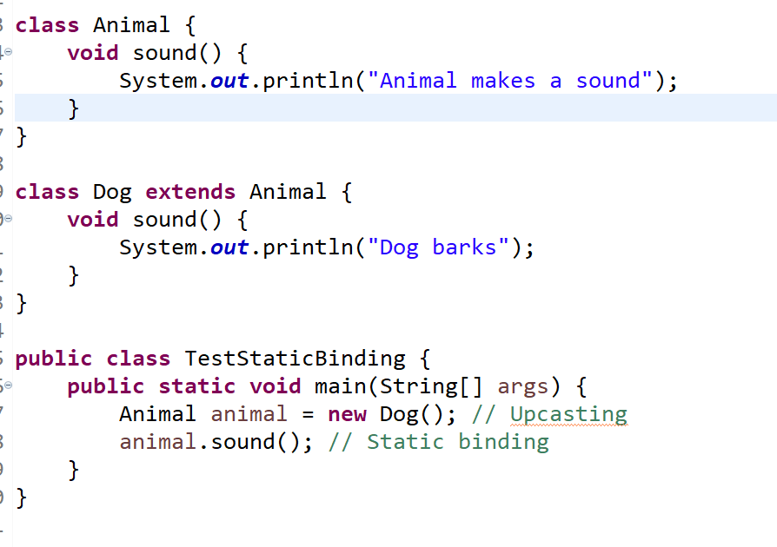

Slide 5
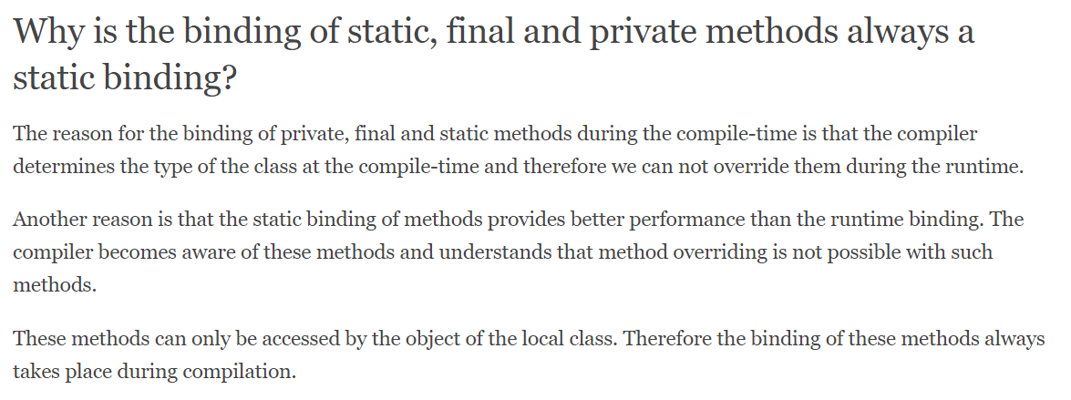

Slide 6
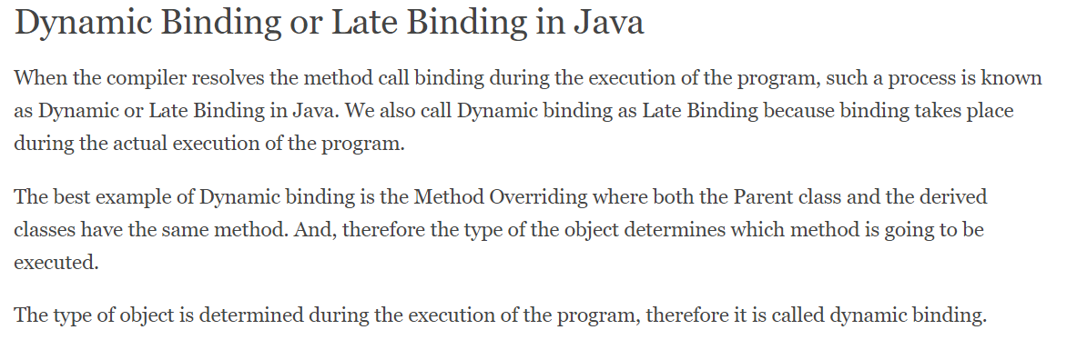

Slide 7
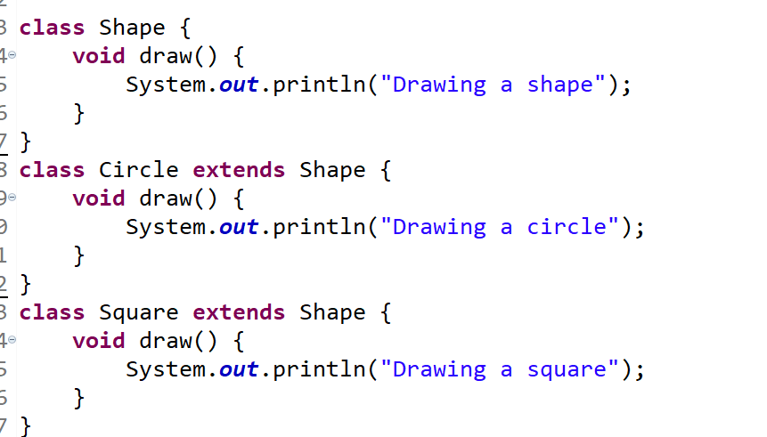
Another ex of binding

Slide 8
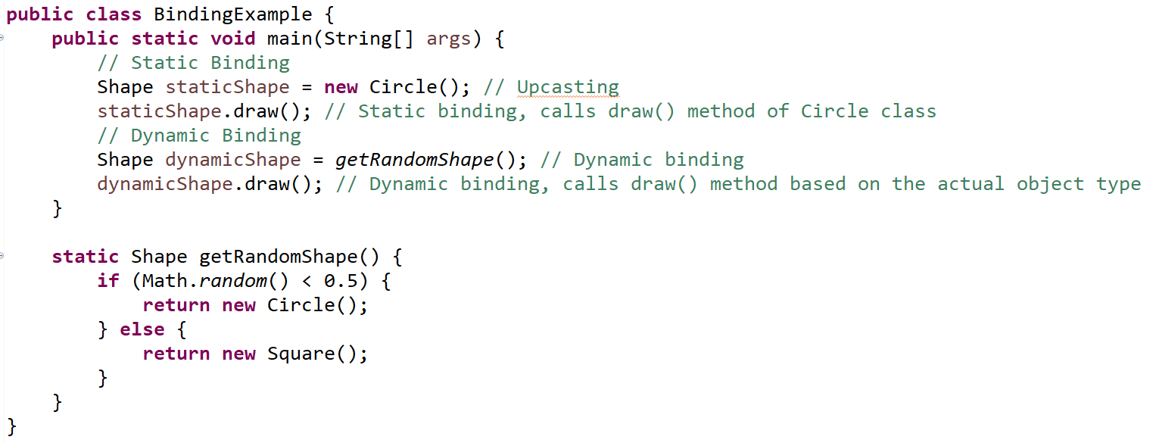

Slide 9
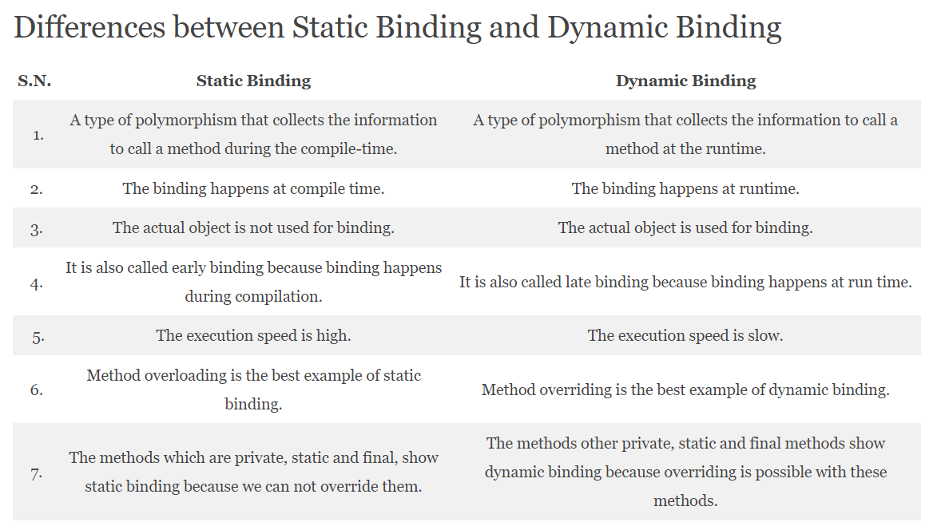

Slide 10
